Slide 1
Secure Data Hiding in Image Using Steganography
CAPSTONE PROJECT
Presented By:
Student Name :
College Name & Department :

Slide 2
OUTLINE
Problem Statement
Technology used
Wow factor
End users
Result
Conclusion
Git-hub Link
Future scope

Slide 3
Problem Statement
In 4 to 5 lines( write in precise words)

Slide 4
Technology used
Mention libraries, platforms,

Slide 5
Wow factors
What makes this project stand out from other project(Unique features)

Slide 6
End users
Who are the end users

Slide 7
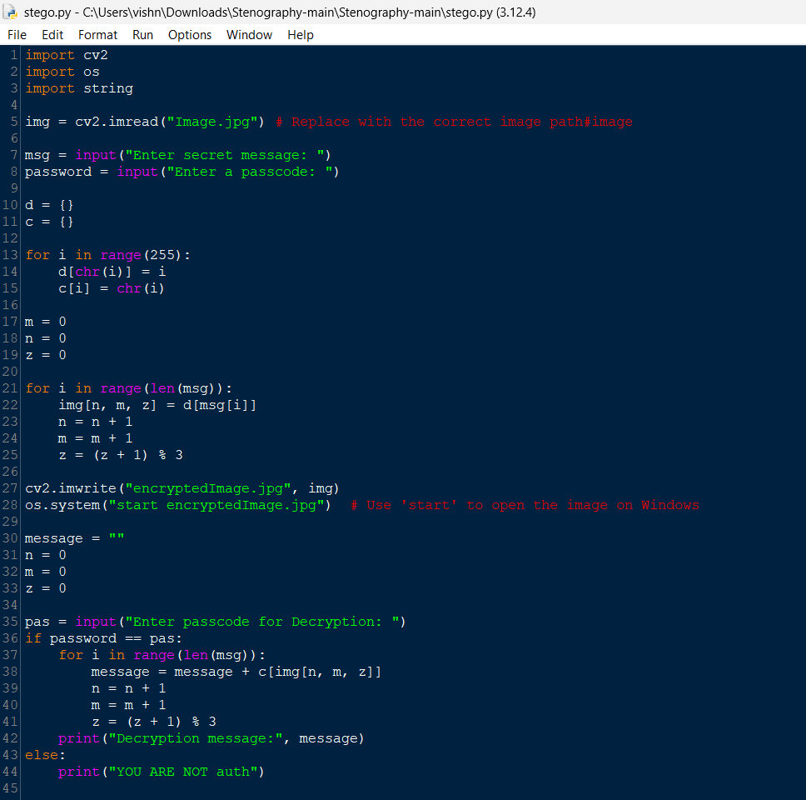
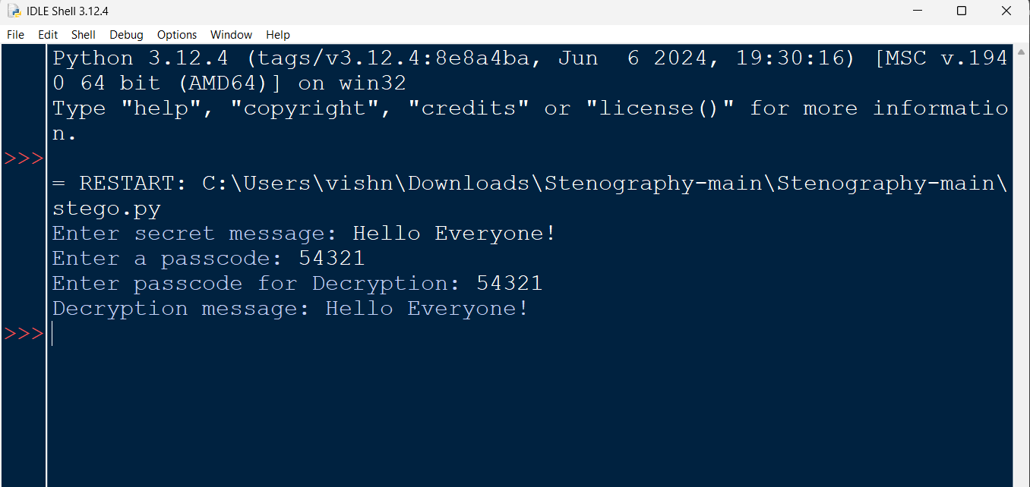
Results

Slide 8
Conclusion
Conclude your project concerning your problem statement

Slide 9
GitHub Link
Make sure that there should be readme file

Slide 10
Future scope(optional)

Slide 11
THANK YOU

